Slide 1



Slide 2
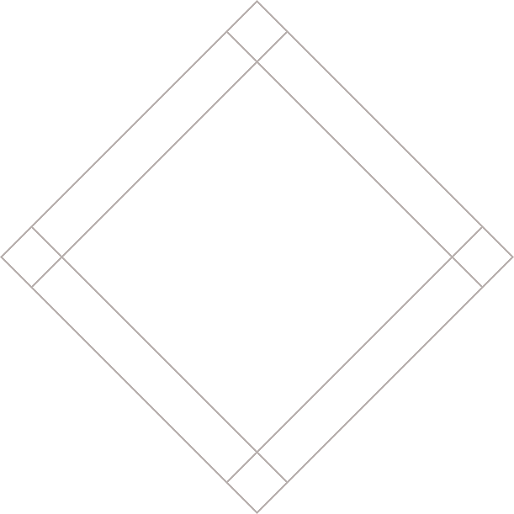


Slide 3

HOW PAGES USE STRUCTURE
HEADLINE

Slide 4
HOW PAGES USE STRUCTURE
TEXT

Slide 5
HOW PAGES USE STRUCTURE
IMAGE

Slide 6
HOW PAGES USE STRUCTURE
SUBHEADING

Slide 7
HOW PAGES USE STRUCTURE
Digital versions often have similar structure

Slide 8
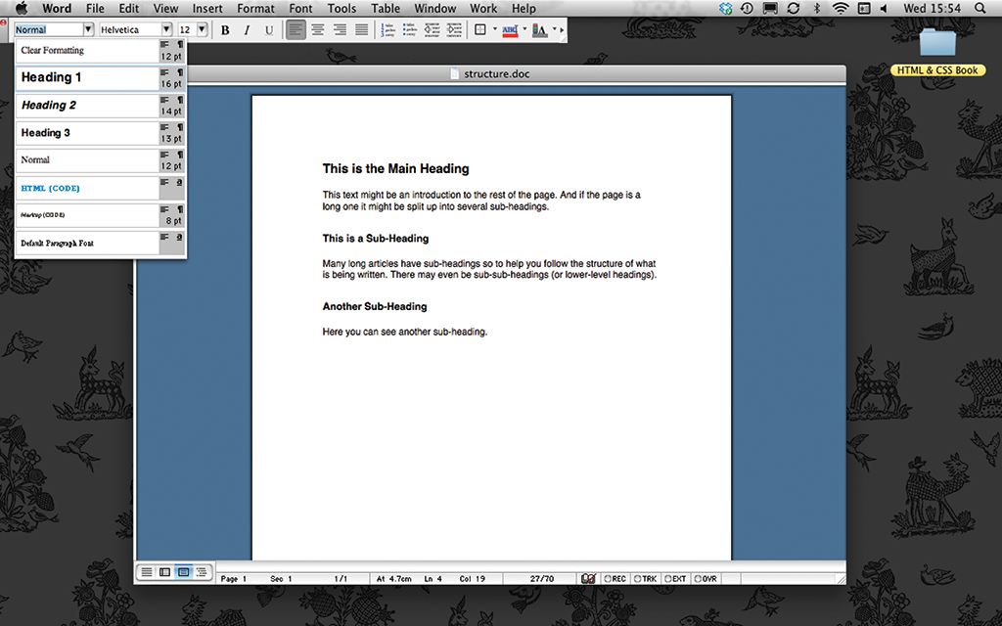
STRUCTURE IN WORD DOCS
Headings and subheadings
reflect hierarchy
of information

Slide 9
STRUCTURE IN WORD DOCS
Main heading
and important information
appear first

Slide 10
STRUCTURE IN WORD DOCS
The information
is expanded upon and may use subheadings

Slide 11
HTML: PAGE STRUCTURE
<html>
<body>
<h1>This is the Main Heading</h1>
<p>This text might be an introduction to
the rest of the page.</p>
<h2>This is a Sub-Heading</h2>
<p>Many long articles have sub-headings
to help you follow the structure.</p>
<h2>Another Sub-Heading</h2>
<p>Here you can see another.</p>
</body>
</html>
Notes:
Explain: HTML uses tags to act like containers. They indicate the structure of things found inside them.
Click: Outlines around <html>
Click: Outlines around <body>
Click: Outlines around <h1>
Click: Outlines around <h2>
Click: Outlines around <p>

Slide 12


A CLOSER LOOK AT TAGS
CHARACTER
CHARACTER
FORWARD SLASH
LEFT-ANGLE BRACKET
RIGHT-ANGLE BRACKET
OPENING TAG
CLOSING TAG
Notes:
Explain: Most tags come in pairs: an opening and closing tag. Mention use of the term "element".
Click: Opening tag
Click: Closing tag
Click: Label for character(s) which indicates purposes of tag
Click: Label for left-angle bracket
Click: Label for right-angle bracket
Click: Label for forward slash

Slide 13
ATTRIBUTES TELL US MORE
ABOUT ELEMENTS
ATTRIBUTE
NAME
<a =" ">Paragraph in English</p>
lang
lang
en-us
en-us
ATTRIBUTE
VALUE
Notes:
Explain: Attributes can be used on opening tags. They tell us more about the content of that element.
Click: Highlights the attribute name
Click: Highlights the attribute value

Slide 14
BODY, HEAD & TITLE
<html>
<head>
<title>This is the Title of...</title>
</head>
<body>
<h1>This is the Body of the Page</h1>
<p>Anything within the body of a web
page is displayed in the main
browser window.</p>
</body>
</html>
Notes:
Explain: The overall structure of a page is comprised of two parts: the <head> and the <body>.

Slide 15
BODY, HEAD & TITLE
<html>
<head>
<title>This is the Title of...</title>
</head>
<body>
<h1>This is the Body of the Page</h1>
<p>Anything within the body of a web
page is displayed in the main
browser window.</p>
</body>
</html>
Notes:
Explain: The <title> tag sits inside the <head> element.

Slide 16
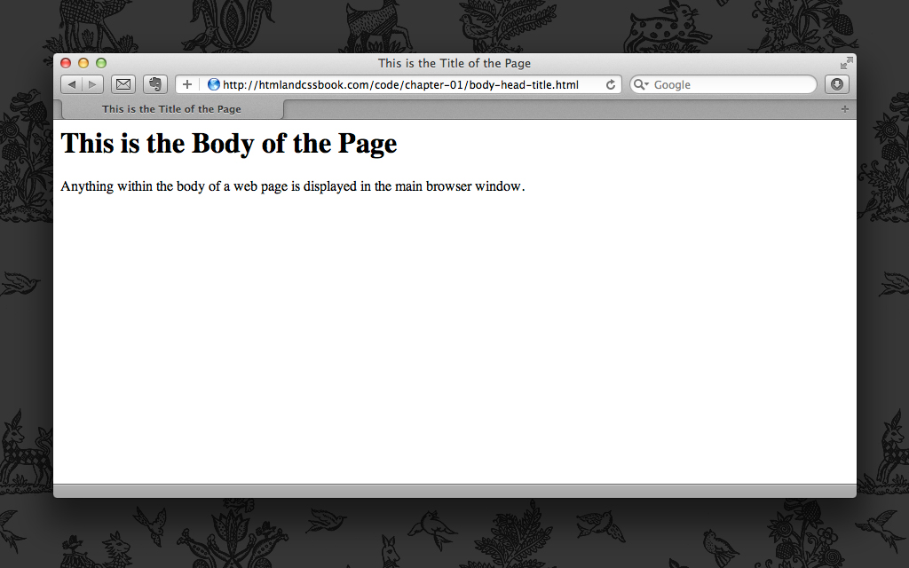
BODY, HEAD & TITLE
Notes:
Explain: This highlights where the content of the <title> tag appears.

Slide 17
BODY, HEAD & TITLE
<html>
<head>
<title>This is the Title of...</title>
</head>
<body>
<h1>This is the Body of the Page</h1>
<p>Anything within the body of a web
page is displayed in the main
browser window.</p>
</body>
</html>
Notes:
Explain: The <body> comes directly after the <head> and everything inside this element is shown in the main browser window.

Slide 18
BODY, HEAD & TITLE
Notes:
Explain: This highlights where the content of the <body> tag appears.

Slide 19
SUMMARY
HTML pages are text documents.
Notes:
Clicks: Load individual bullet points.

Slide 20
SUMMARY
HTML uses tags, which act like containers and tell you about the information that lies between them.

Slide 21
SUMMARY
Tags are often referred to as elements.

Slide 22
SUMMARY
Tags usually come in pairs. Opening tags denote the start of a piece of content; closing tags denote the end.

Slide 23
SUMMARY
Opening tags can carry attributes, which tell us more about the content of that element.

Slide 24
SUMMARY
Attributes require a name and a value.

Slide 25
SUMMARY
To learn HTML you need to know what tags you can use, what they do, and where they can go.

Slide 26
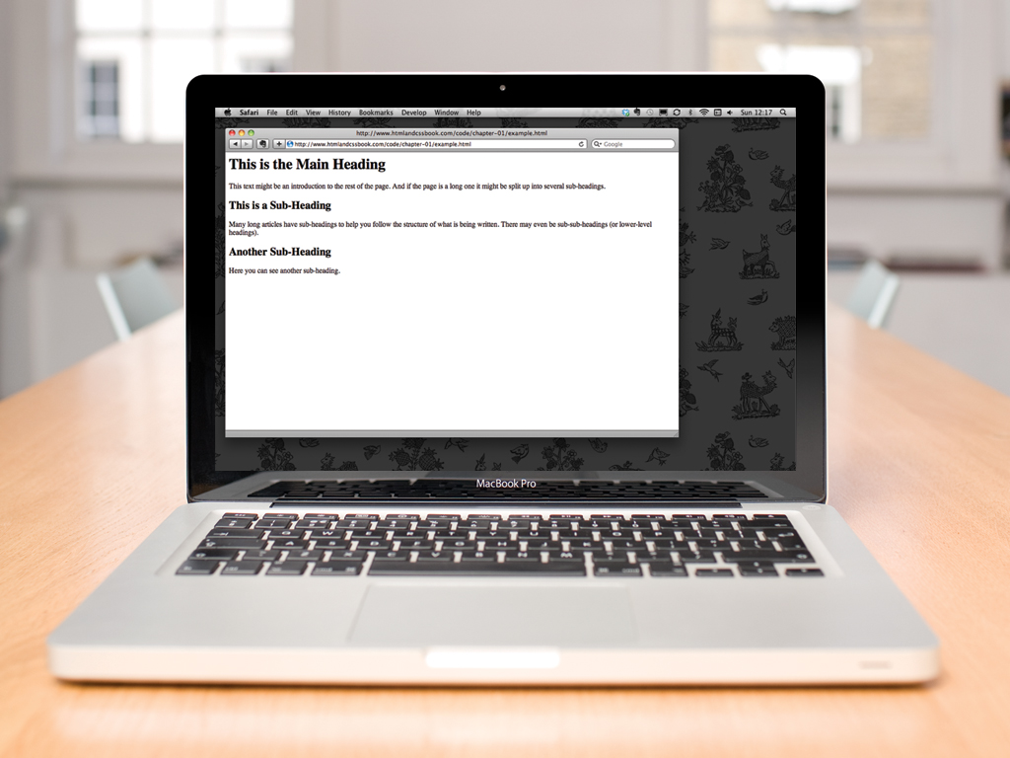

Slide 27


